Slide 1
Teaching in a Thinking Classroom
Peter Liljedahl

Slide 2
Recap
Just do it!
change the rules
change the game
Don’t blow it!
never relent
be vigilant (of yourself)
Use it!
…
…

Slide 3
Planning for Next Year
first day
first week
first homework
first quiz
first test
first re-test

Slide 4
Planning for Next Year
first day
first week
first homework
first quiz
first test
first re-test
assessment

Slide 5
Using a Thinking Classroom
review is faster
can rely on knowledge in the room (no silos)
level less – and to the bottom
easier to differentiate
less fragmentation
more time to work/think
less homework
…

Slide 6
Assessment/Evaluation
Evaluation is a double edged sword – when we evaluate our students they evaluate us. For, what we chose to evaluate shows what it is we value. (Peter Liljedahl)
Not everything that can be measured matters, and not everything that matters can be measured. (Albert Einstein – sort of)

Slide 7
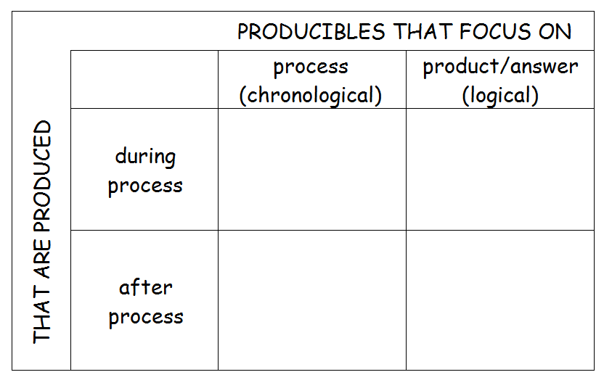
Producibles

Slide 8
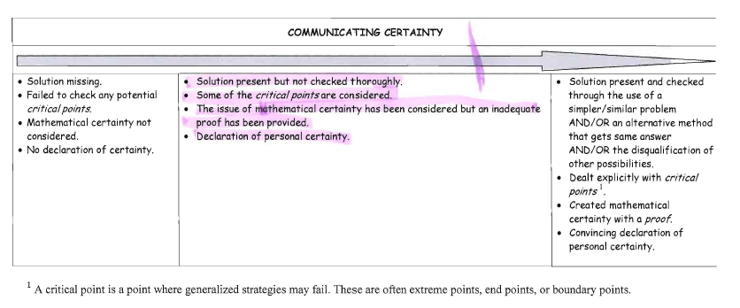
Rubrics

Slide 9
Rubrics

Slide 10
Thank you
liljedahl@sfu.ca

